Slide 1
STEP0 :
Reduced the Matrix
Original Matrix
 | J1 | J2 | J3 | J4 | J5
P1 | 17 | 13 | 4 | 23 | 12
P2 | 32 | 30 | 45 | 19 | 31
P3 | 7 | 11 | 12 | 3 | 15
P4 | 10 | 17 | 13 | 9 | 11
P5 | 8 | 19 | 9 | 6 | 7

Slide 2
STEP0 :
Reduced the Matrix
Reduced Matrix
 | J1 | J2 | J3 | J4 | J5
P1 | 13 | 9 | 0 | 20 | 7
P2 | 13 | 11 | 26 | 1 | 11
P3 | 4 | 8 | 9 | 1 | 11
P4 | 1 | 8 | 4 | 1 | 1
P5 | 2 | 13 | 3 | 1 | 0
-4
-19
-3
-9
-6

Slide 3
STEP0 :
Reduced the Matrix
Another Reduced Matrix
 | J1 | J2 | J3 | J4 | J5
P1 | 12 | 1 | 0 | 19 | 7
P2 | 12 | 3 | 26 | 0 | 11
P3 | 3 | 0 | 9 | 0 | 11
P4 | 0 | 0 | 4 | 0 | 1
P5 | 1 | 5 | 3 | 0 | 0
-4
-19
-3
-9
-6
-1
-8
-1
基本開銷: 4 + 19 + 3 + 9 + 6 + 1 + 8 + 1 = 51

Slide 4
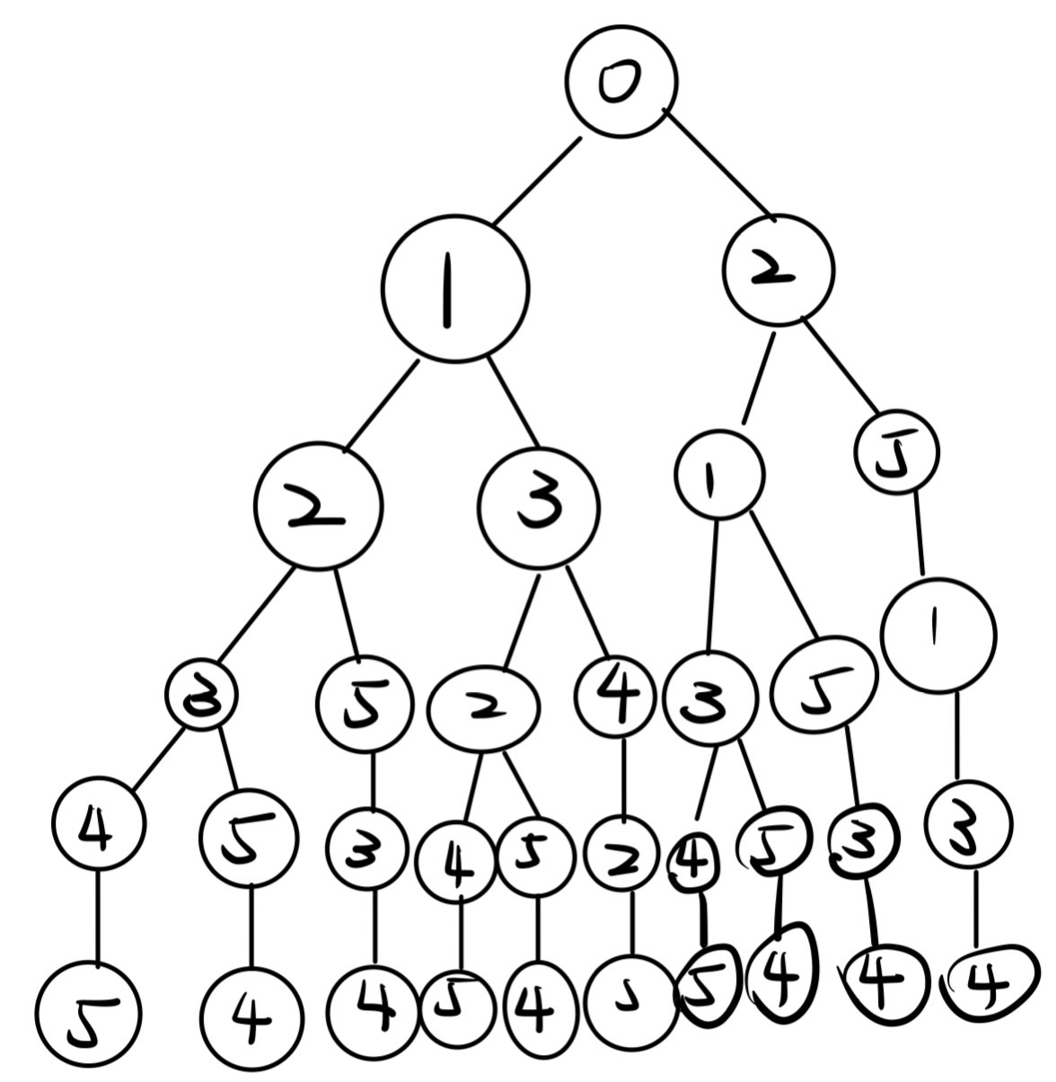
STEP1:
Solution Tree
COST MATRIX
 | J1 | J2 | J3 | J4 | J5
P1 | 12 | 1 | 0 | 19 | 7
P2 | 12 | 3 | 26 | 0 | 11
P3 | 3 | 0 | 9 | 0 | 11
P4 | 0 | 0 | 4 | 0 | 1
P5 | 1 | 5 | 3 | 0 | 0

Slide 5
51
STEP2:
Searching
COST MATRIX
 | J1 | J2 | J3 | J4 | J5
P1 | 12 | 1 | 0 | 19 | 7
P2 | 12 | 3 | 26 | 0 | 11
P3 | 3 | 0 | 9 | 0 | 11
P4 | 0 | 0 | 4 | 0 | 1
P5 | 1 | 5 | 3 | 0 | 0

Slide 6
51
STEP2:
Searching
63
52
COST MATRIX
 | J1 | J2 | J3 | J4 | J5
P1 | 12 | 1 | 0 | 19 | 7
P2 | 12 | 3 | 26 | 0 | 11
P3 | 3 | 0 | 9 | 0 | 11
P4 | 0 | 0 | 4 | 0 | 1
P5 | 1 | 5 | 3 | 0 | 0

Slide 7
51
STEP2:
Searching
63
52
64
63
COST MATRIX
 | J1 | J2 | J3 | J4 | J5
P1 | 12 | 1 | 0 | 19 | 7
P2 | 12 | 3 | 26 | 0 | 11
P3 | 3 | 0 | 9 | 0 | 11
P4 | 0 | 0 | 4 | 0 | 1
P5 | 1 | 5 | 3 | 0 | 0

Slide 8
51
STEP2:
Searching
63
52
67
64
63
89
COST MATRIX
 | J1 | J2 | J3 | J4 | J5
P1 | 12 | 1 | 0 | 19 | 7
P2 | 12 | 3 | 26 | 0 | 11
P3 | 3 | 0 | 9 | 0 | 11
P4 | 0 | 0 | 4 | 0 | 1
P5 | 1 | 5 | 3 | 0 | 0

Slide 9
51
STEP2:
Searching
63
52
67
64
63
89
66
COST MATRIX
 | J1 | J2 | J3 | J4 | J5
P1 | 12 | 1 | 0 | 19 | 7
P2 | 12 | 3 | 26 | 0 | 11
P3 | 3 | 0 | 9 | 0 | 11
P4 | 0 | 0 | 4 | 0 | 1
P5 | 1 | 5 | 3 | 0 | 0

Slide 10
51
STEP2:
Searching
63
52
67
64
63
89
66
73
75
COST MATRIX
 | J1 | J2 | J3 | J4 | J5
P1 | 12 | 1 | 0 | 19 | 7
P2 | 12 | 3 | 26 | 0 | 11
P3 | 3 | 0 | 9 | 0 | 11
P4 | 0 | 0 | 4 | 0 | 1
P5 | 1 | 5 | 3 | 0 | 0

Slide 11
51
STEP2:
Searching
63
52
67
64
63
89
66
73
75
COST MATRIX
 | J1 | J2 | J3 | J4 | J5
P1 | 12 | 1 | 0 | 19 | 7
P2 | 12 | 3 | 26 | 0 | 11
P3 | 3 | 0 | 9 | 0 | 11
P4 | 0 | 0 | 4 | 0 | 1
P5 | 1 | 5 | 3 | 0 | 0
70

Slide 12
51
STEP2:
Searching
63
52
67
64
63
89
66
73
75
76
78
COST MATRIX
 | J1 | J2 | J3 | J4 | J5
P1 | 12 | 1 | 0 | 19 | 7
P2 | 12 | 3 | 26 | 0 | 11
P3 | 3 | 0 | 9 | 0 | 11
P4 | 0 | 0 | 4 | 0 | 1
P5 | 1 | 5 | 3 | 0 | 0
70

Slide 13
51
STEP2:
Searching
63
52
67
64
63
89
66
73
75
76
78
COST MATRIX
 | J1 | J2 | J3 | J4 | J5
P1 | 12 | 1 | 0 | 19 | 7
P2 | 12 | 3 | 26 | 0 | 11
P3 | 3 | 0 | 9 | 0 | 11
P4 | 0 | 0 | 4 | 0 | 1
P5 | 1 | 5 | 3 | 0 | 0
70
70

Slide 14
51
STEP2:
Searching
63
52
67
64
63
89
66
73
75
76
78
COST MATRIX
 | J1 | J2 | J3 | J4 | J5
P1 | 12 | 1 | 0 | 19 | 7
P2 | 12 | 3 | 26 | 0 | 11
P3 | 3 | 0 | 9 | 0 | 11
P4 | 0 | 0 | 4 | 0 | 1
P5 | 1 | 5 | 3 | 0 | 0
70
70

